Slide 1
Cable ring routing: our optimization algorithm
One search over hub count, connected zones, device positions and cable paths
Team: Bro Code Members: Jahnavi sri Sai Akveti, Nakshatra Vinoth , Kaustubh Borle
Solver pipeline
Assumptions and choices
• Place one device per eligible room, at least 0.5 m from nearby walls and windows.
• Use real door connections. Each hub covers ≤5 devices and ≤100 m².
• Complete every ring at its starting panel. Route only horizontal and vertical cable.
• Treat walls and windows as blocked. Use excluded rooms only if strict routing has no path.
• Ignore room components below 2 m². Use ResPlan.pkl for plan IDs and evaluation.
ResPlan ID
Geometry + devices
Door graph
True connectivity
Feasible zones
≤5 nodes, ≤100 m²
Ring candidates
A* paths + Held-Karp
Global CP-SAT
Select the best rings
ALNS
Improve J by repair
Checker + output
Validate, export, view
Lexicographic objective: min H then J = L + 5X + O + 0.5B then ΔA gap
CP-SAT certifies H when it finishes; cable cost is the best found within the candidate pool and time.
Intermediate update • 16 October 2026
Intermediate update | Team: Bro Code 1 / 3
Notes:
This hybrid solver is our project approach to the challenge.
CP-SAT proves the minimum hub count over connected feasible zones.
Held-Karp solves the visit order for up to five devices, while direction-state A* supplies legal rectilinear paths.
A ring candidate contains the zone, positions, order and complete geometry. Global CP-SAT accounts for interactions between rings.
ALNS then perturbs rooms, positions and paths, while preserving the best checked solution.

Slide 2
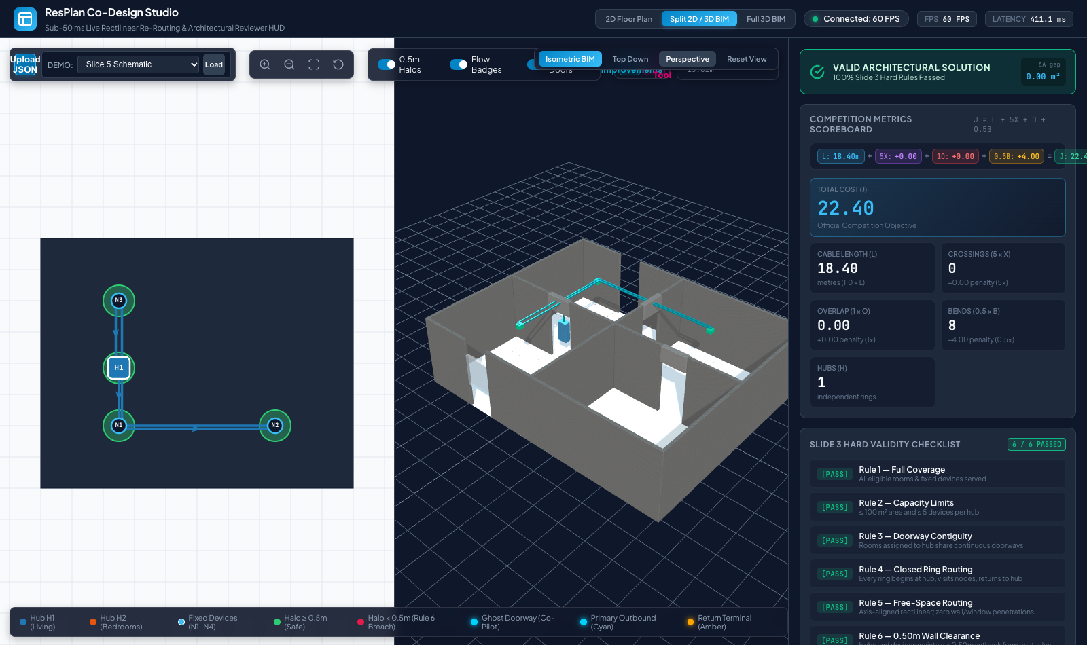
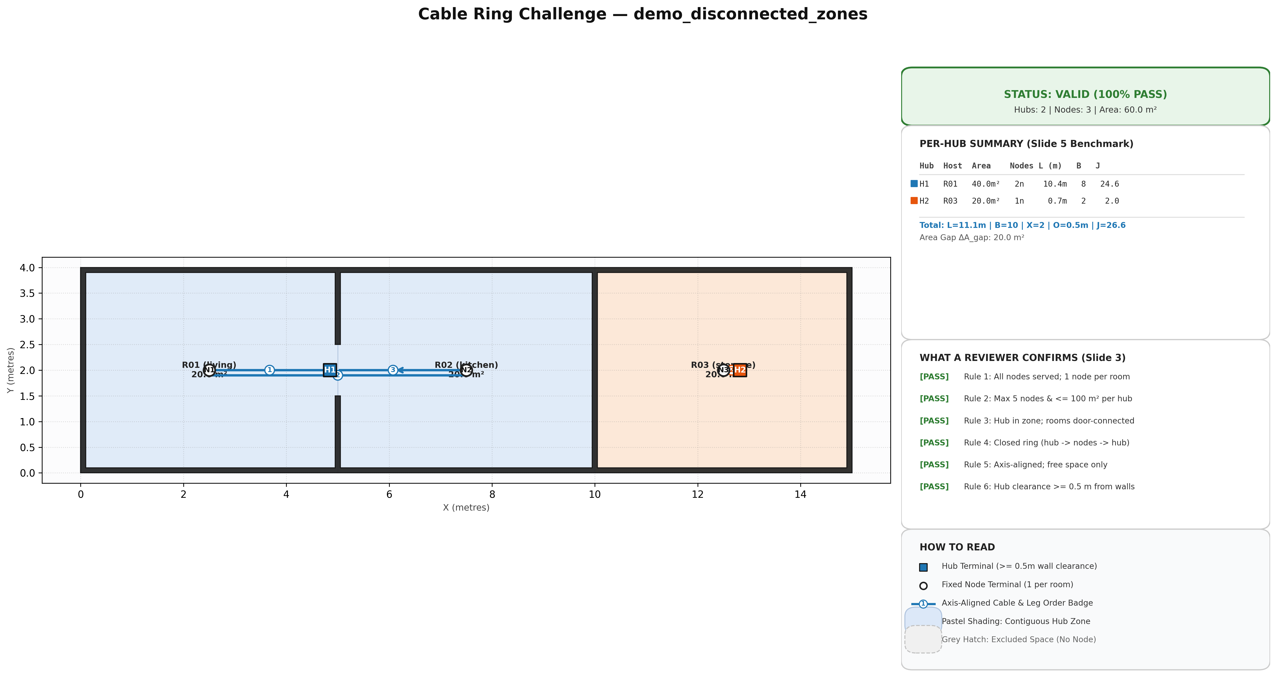
Algorithm mechanics and validation case
A complete ring must be selected globally because individually short paths can cross
The optimization model
1 Prove the smallest hub count
Enumerate door-connected zones and solve an exact room cover with CP-SAT.
2 Generate complete alternatives
Direction-aware A* supplies several legal paths. Held-Karp solves each ≤5-device visit order.
3 Price routes together
Choose one ring per covered zone. Include crossing and overlap costs between rings.
4 Improve under a deadline
ALNS moves a room, hub, device or path, then retains the best checked result.
H 1 L 18.40 m B 8 X 0 O 0
J 22.40 6 of 6 hard rules pass
Current: H 2, J 26.57
Checked alternative: H 2, J 15.975
For each room i: Σ(r contains i) xᵣ = 1
Hub lower bound: Σc max(⌈Ac/100⌉, ⌈Nc/5⌉)
Working geometry and checker prototype
Why joint route selection matters
Intermediate update • 16 October 2026
Intermediate update | Team: Bro Code | 2 / 3
Notes:
The left image is the working geometry, visualisation and checker prototype. It is evidence of the implementation foundation, not a result from the complete hybrid optimizer.
The right image is the key optimization counterexample. The current route is valid but costs 26.57.
A second independently checked route uses the same two hubs and costs 15.975. This motivates global selection of complete ring alternatives.

Slide 3
Implementation and evaluation plan
The solver is judged against a greedy baseline on valid plans from ResPlan.pkl
Engineering tasks and checks
Why this algorithm fits the challenge
1. Plan ID and device placement
Index ResPlan.pkl once. Generate legal device candidates after metric conversion.
2. Candidate pool quality
Vary placements, orders and paths so global CP-SAT can find lower-crossing rings.
3. Runtime and proof status
Cache geometry and routes. Report exact hub proof and a bounded cable-cost gap.
4. Held-out evaluation
Measure validity, J and latency against the required greedy baseline.
Small rings permit exact ordering: at most five devices per hub keeps Held-Karp cheap.
Graph search handles the geometry: direction state prices bends while walls and doors constrain every path.
CP-SAT handles global choices: room coverage, hub count and cross-ring conflicts share one model.
ALNS makes search anytime: the best valid incumbent survives every time limit.
Next steps and help needed
Load a Plan ID • build a greedy baseline • prove minimum H • generate K routes and complete rings • select globally • improve with ALNS
Request to organisers: final input schema and automated checker, if available.
Intermediate update • 16 October 2026
Intermediate update | Team: Bro Code | 3 / 3
Notes:
This is the implementation plan for the project's hybrid optimizer.
The global candidate selector closes the concrete gap observed on the disconnected case.
ALNS adds improvement under a time limit without sacrificing a valid incumbent.
The dataset supports benchmarking and parameter tuning. No machine-learning training is required for the core solver.

